Slide 1
Authentication: Overview

Slide 2
What is authentication?
Positive verification of identity (man or machine)
Verification of a person’s claimed identity
Who are you? Prove it.
3 Categories:
  What you know
  What you have
  Who you are

Slide 3
What you know
Password
Passphrase
PIN

Slide 4
What you have
Digital authentication
  physical devices to aid authentication
Common examples:
  eToken
  smart cards
  RFID

Slide 5
eToken
Can be implemented on a USB key fob or a smart card
Data physically protected on the device itself
On the client side, the token is accessed via password
Successful client-side authentication with the password invokes the token to generate a stored or generated passcode, which is sent to the server-side for authentication.

Slide 6
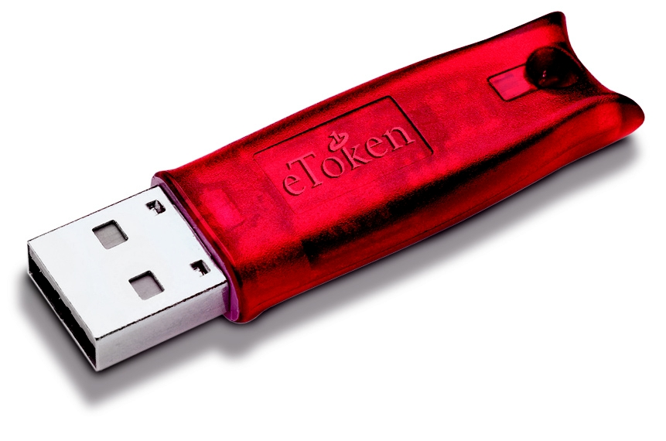
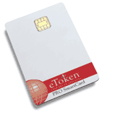
eToken
May store credentials such as passwords, digital signatures and certificates, and private keys
Can offer on-board authentication and digital signing

Slide 7
Smart cards
Size of a credit card
Usually an embedded microprocessor with computational and storage capabilities
Programmable platforms:
  C/C++
  Visual Basic
  Java
  .Net (beta)

Slide 8
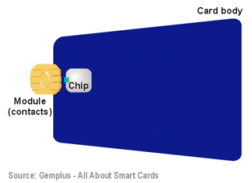
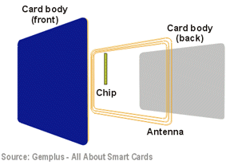
Smart Cards cont’d
Contact vs. contactless
Memory vs. microprocessor

Slide 9
RFID
RFID - Radio Frequency IDentification
Integrated circuit(s) with an antenna that can respond to an RF signal with identity information
No power supply necessary—IC uses the RF signal to power itself
Susceptible to replay attacks and theft
Examples:
  Smart Tag, EZPass
  Garage parking permits

Slide 10
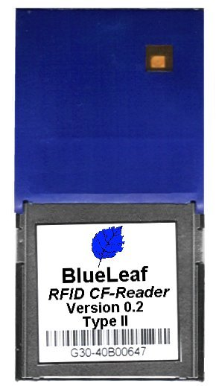
RFID
13.56Mhz read/write support
May communicate with a variety of transponders (ISO15693, ISO14443 Type A & B, TagIt, Icode, etc.)
Reader is controlled via PCMCIA interface using an ASCII protocol

Slide 11
Who you are
Biometric authentication
  Use of a biometric reading to confirm that a person is who he/she claims to be
Biometric reading
  A recording of some physical or behavioral attribute of a person

Slide 12
Physical Biometrics
Fingerprint
Iris
Hand Geometry
Finger Geometry
Face Geometry
Ear Shape
Retina
Smell
Thermal Face
Hand Vein
Nail Bed
DNA
Palm Print

Slide 13
Behavioral Biometrics
Signature
Voice
Keystroke
Gait (Manner of Walking)

Slide 14
Fingerprints
Vast amount of data available on fingerprint pattern matching
Data originally from forensics
Over 100 years of data to draw on
  Thus far all prints obtained have been unique

Slide 15
Fingerprint Basics
Global features
  Features that can be seen with the naked eye
  Basic ridge patterns
Local features
  Minutia points
  Tiny unique characteristics of fingerprint ridges used for positive identification

Slide 16
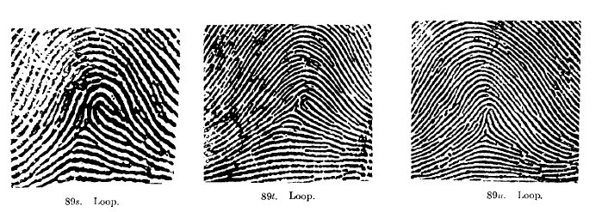
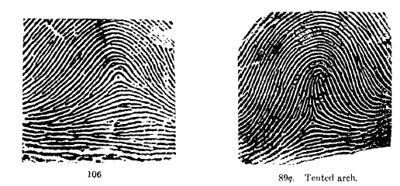
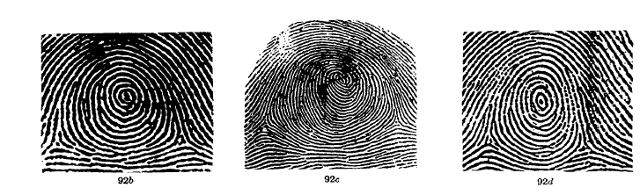
Basic Ridge Patterns
Loop
65% of all fingerprints
Arch
Plain and tented arch
Whorl
30% of all fingerprints
One complete circle

Slide 17
Local Features
Also known as minutia points
Used for positive identification
Two or more individuals may have the same global features, but different minutia
Minutia points do not have to be inside the pattern area

Slide 18


Types of Minutia
Ridge ending
Ridge bifurcation
Ridge divergence
Dot or island – ridge so short it appears to be a dot
Enclosure – ridge separates and then reunites around an area of ridge-less skin
Short ridge – bigger than a dot

Slide 19
Minutia Characteristics
Orientation
  The direction the minutia is facing
Spatial frequency
  How far apart the ridges are around the point
Curvature
  Rate of change of orientation
Position
  X,Y location relative to some fixed points

Slide 20
Algorithms
Image-based
Pattern-based
Minutia-based

Slide 21
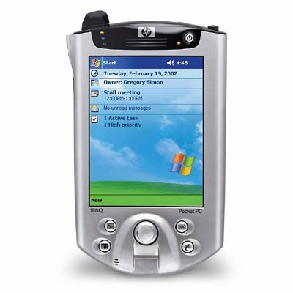
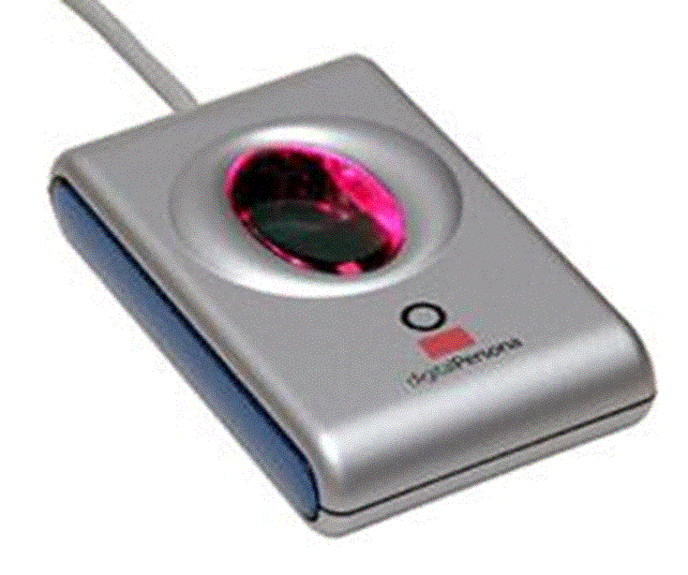
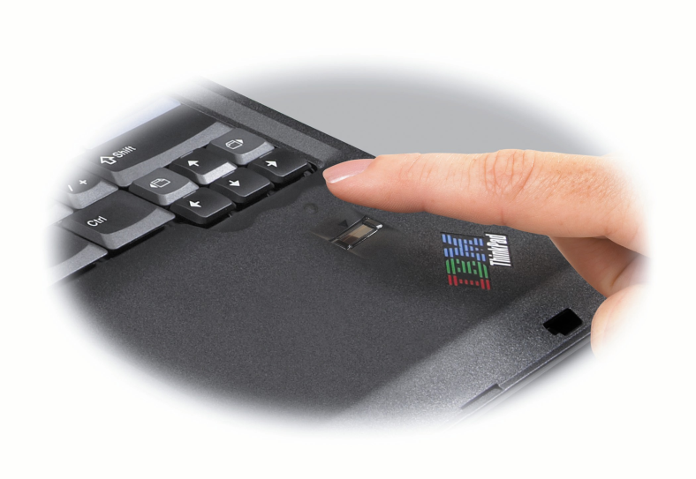
Fingerprint Scanners
Digital Persona U.are.U Pro
HP IPAQ
IBM Thinkpad T42

Slide 22
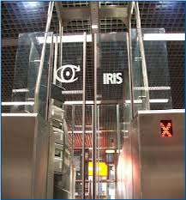
Iris Recognition
Iris recognition is a method of biometric identification and authentication that use pattern-recognition techniques based on high resolution images of the irises of an individual's eyes .
It is considered to be the most accurate biometric technology available today.

Slide 23
Why the Iris?
Externally visible highly protected internal organ.
Unique patterns.
Not genetically connected unlike eye color.
Stable with age.
Impossible to alter surgically.
Living Password, Can not be forgotten or copied.
Works on blind person.
User needs not to touch appliances.
Accurate , faster , and supports large data base.

Slide 24
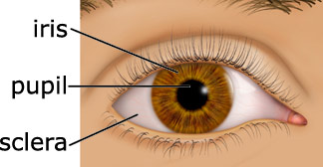
What is Iris ?
The iris is a thin circular diaphragm, which lies between the cornea and the lens of the human eye.
The iris is perforated close to its centre by a circular aperture known as the pupil.
The function of the iris is to control the amount of light entering through the pupil.
The average diameter of the iris is 12 mm, and the pupil size can vary from 10% to 80% of the iris diameter [2].

Slide 25







Iris Recognition Diagram
Iris Segmentation
Image Acquisition
Normalization
Eye Image
Iris Region
Feature points in the iris region
Feature Matching
Feature Encoding
Identify or Reject Subject
Iris Template
Iris Templates Database

Slide 26
Biometric Authentication Terms
False Acceptance Rate (FAR)
  False Match Rate (FMR)
  Percentage of access attempts by unauthorized individuals which are nevertheless successful
False Rejection Rate (FRR)
  False Non-Match Rate (FNMR)
  Percentage of access attempts by enrolled individuals who are nevertheless rejected
Equal Error Rate
  FAR = FRR

Slide 27
Review: Three Categories
What you know
  Password
  PIN
What you have
  e-Token
  RFID
Who you are
  Biometrics

Slide 28
Motivation
Real-world considerations:
  What you know and what you have
    Can be stolen or forgotten
    Susceptible to replay attacks
  Who you are
    Unique biometrics that hinder replay attacks and imposters
    Privacy issues arise

Slide 29
Bibliography
Authentication
  L. O’Gorman, “Comparing Passwords, Tokens, and Biometrics for User Authentication,” Proc. IEEE, Vol. 91, No. 12, Dec. 2003, pp. 2019-2040.
Kerberos
  http://www.computerworld.com/computerworld/records/images/pdf/kerberos_chart.pdf
CS453 class slides

